Slide 1
CE 395 R5 - Data Mining Classification (SVM)

Slide 2
Support Vector Machines (SVM)
Find a linear hyperplane (decision boundary) that will separate the data

Slide 3
SVM (2)
One Possible Solution

Slide 4
SVM (3)
Another possible solution

Slide 5
SVM (4)
Other possible solutions

Slide 6
SVM (5)
Which one is better? B1 or B2?
How do you define better?

Slide 7
SVM (6)
Find hyperplane maximizes the margin => B1 is better than B2

Slide 8
SVM - Advantages
Mathematical formulation
High dimensional feature spaces
Generalization
Excellent results in some applications

Slide 9
SVM – Model Building
Support Vector Machines (SVM)
Binary Classification
Linearly Separable Case
Training Data
Feature vectors in an n-dimensional space

Slide 10
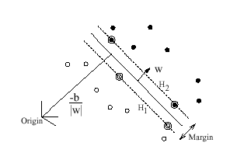
SVM – Model Building (2)
Separating hyperplane
Separates positive from the negative examples

Slide 11

SVM – Model Building (3)
Points in the hyperplane satisfy
Where,
w is normal to the hyperplane
|b| / ||w|| is the perpendicular distance from the hyperplane to the origin
||w|| is the Euclidian norm of w

Slide 12
SVM – Model Building (4)
Let d₊ (d₋) be the shortest distance from the separating hyperplane to the closest positive (negative) example.
The margin of the separating hyperplane is given by:
d₊ + d₋
For the linearly separable case, the support vector algorithm looks for the separating hyperplane with largest margin.

Slide 13
SVM – Model Building (5)
Formulation:
Suppose that all training data satisfy the following constraints
These can be combined into one set of inequalities

Slide 14
SVM – Model Building (6)

Slide 15
SVM – Model Building (7)
H₁:
Has w as a normal vector and
Perpendicular distance to the origin |1-b| / ||w||
H₂:
Has w as a normal vector and
Perpendicular distance to the origin |-1-b| / ||w||
Hence, d₊ = d₋ = 1 / ||w||
Margin is given by 2 / ||w||

Slide 16
SVM – Model Building (8)
Solution:
Minimize ||w||² / 2, subject to the constraints:
Calculate w and b

Slide 17
SVM – Model Building (9)
Lagrangian formulation
Solution given by
Where x_{r} and x_{s} are any support vector from each class satisfying
α_{r}, α_{s} > 0, y_{r} = -1, y_{s} = 1

Slide 18
SVM – Classification of New Instances

Slide 19
References
Burges, C.J.C. (1998) “A tutorial on support vector machines for pattern recognition.” Data Mining and Knowledge Discovery, 2(2):955-974. http://citeseer.ist.psu.edu/burges98tutorial.html
Duda, R. O., Hart, P. E., and Stork, D. G. (2000) Pattern Classification. Wiley-Interscience
Dibike, Y. B., Velickov, S., Solomatine, D., and Abbott, M. B. (2001) “Model induction with support vector machines: introduction and applications.” Journal of Computing in Civil Engineering, 15(3), 208-216.

Slide 20
Support Vector Machines
What if the problem is not linearly separable?

Slide 21
Support Vector Machines
What if the problem is not linearly separable?
Introduce slack variables
Need to minimize:
Subject to:

Slide 22
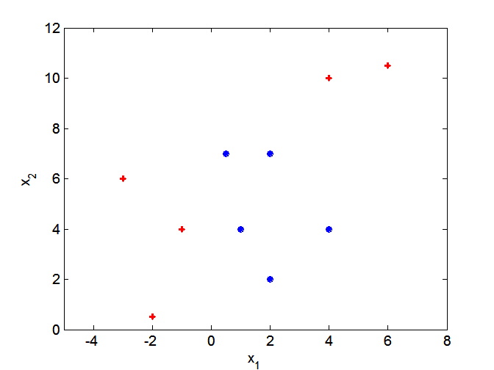
Nonlinear Support Vector Machines
What if decision boundary is not linear?

Slide 23
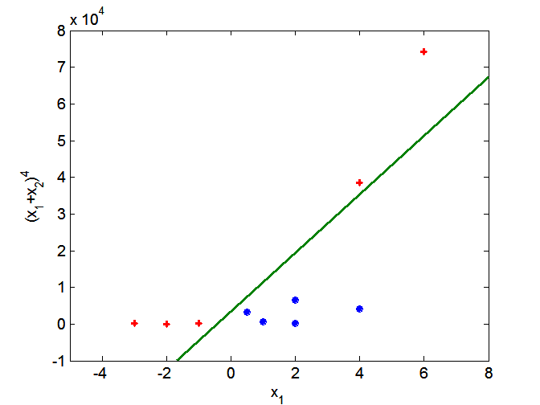
Nonlinear Support Vector Machines
Transform data into higher dimensional space

Slide 24
Characteristics of SVM
Since the learning problem is formulated as a convex optimization problem, efficient algorithms are available to find the global minima of the objective function (many of the other methods use greedy approaches and find locally optimal solutions)
Overfitting is addressed by maximizing the margin of the decision boundary, but the user still needs to provide the type of kernel function and cost function
Difficult to handle missing values
Robust to noise
High computational complexity for building the model

Slide 25
CE 395 R5 - Data Mining Classification (Ensemble)

Slide 26
Ensemble Methods
Construct a set of classifiers from the training data
Predict class label of previously unseen records by aggregating predictions made by multiple classifiers

Slide 27
General Idea

Slide 28
Types of Ensemble Methods
Manipulate data distribution
Example: bagging, boosting
Manipulate input features
Example: random forests
Manipulate class labels
Example: error-correcting output coding

